Slide 1
INFDEV036A - Algorithms Lesson Unit 3b
G. Costantini, F. Di Giacomo
costg@hr.nl, giacf@hr.nl – Office H4.206

Slide 2
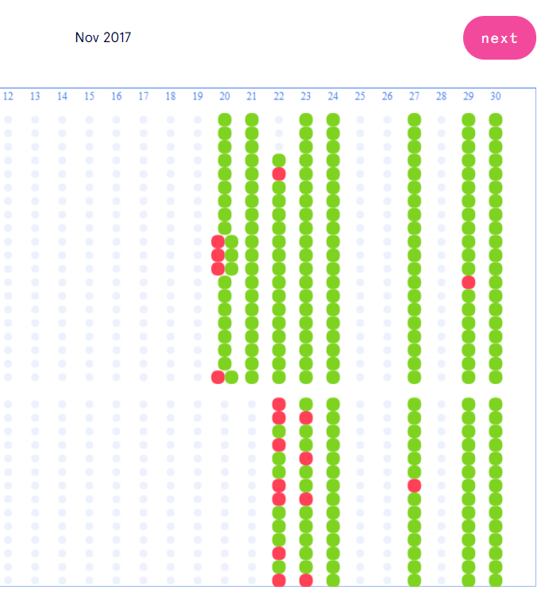
Homework progress
Have you completed all MC questions in GrandeOmega?
Have you implemented all algorithms+data structures seen in the previous lessons?

Slide 3
Recap about exam
We start with the written exam
MC questions in Grande Omega
Most likely, approx 20 questions with 6 answers each
After delivery you see how many questions were wrong
Immediately followed by the practical assessment
C# code in Visual Studio
A few algorithms with some lines of code missing, to be completed by you
Not allowed to change the logic of the code (you have to fill in specific lines)
Grade is visible in real-time

Slide 4
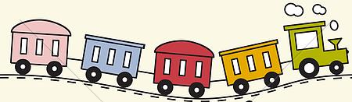



Today
LIST
Why is my code slow?
Empirical and complexity analysis
How do I order my data?
Sorting algorithms
How do I structure my data?
Linear, tabular, recursive data structures
How do I represent relationship networks?
Graphs
QUEUE
STACK
HASH TABLE

Slide 5

Hash table

Slide 6

Hash table - Definitions
Hash table → data structure used to implement an associative array, a structure that can map keys to values
Hash table → container that allows direct access by any index type: it works like an array except that the index variable does not need to be an integer
Also called: hash map, lookup table, associative array, dictionary
Analogy with the dictionary: index = word to look up; value indexed = dictionary definition

Slide 7
Hash table - Definitions
Hash table → data structure used to implement an associative array, a structure that can map keys to values
Hash table → container that allows direct access by any index type: it works like an array except that the index variable does not need to be an integer
Also called: hash map, lookup table, associative array, dictionary
Analogy with the dictionary: index = word to look up; value indexed = dictionary definition
Entries of a hash table are called “key-value” pairs
Key → index into the table
Value → information being looked up

Slide 8
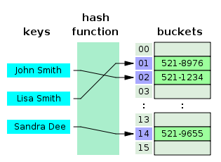
Hash table - Definition
Hashing idea → distribute the entries (key/value pairs) across an array of buckets (also called slots)
A hash function is used to compute the index in the buckets array, from which the correct value can be found
Example (phone book)

Slide 9
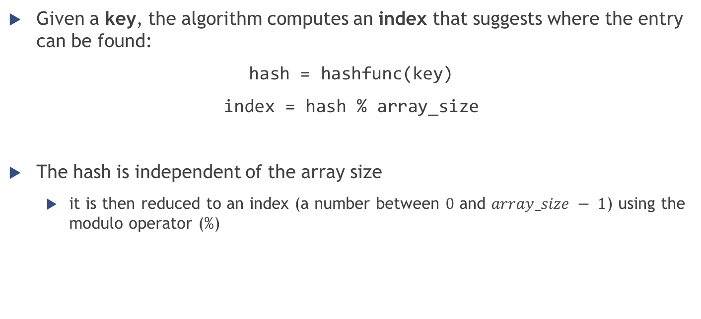
Hash table - Definition
Given a key, the algorithm computes an index that suggests where the entry can be found:
hash = hashfunc(key)
index = hash % array_size
The hash is independent of the array size
it is then reduced to an index (a number between $0$ and $array_size − 1$) using the modulo operator (%)

Slide 10
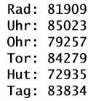
Hash table - Definition
In Java and .NET, every object is associated to a hash code (computed from the actual hard data stored in the object), accessible through the methods:
[Java] Object.hashCode()
[.NET] Object.GetHashCode()
Example: hash codes of some strings made by three characters
hash = hashfunc(key)
Notes:
http://jsfiddle.net/Ciul/w42en/

Slide 11


Hash table - Definition
After computing the hash code, we must compute the index inside the array
Suppose that array_size = 11
Index of Rad: 81901 % 11 = 3
Index of Uhr: 85023 % 11 = 4
Index of Ohr: 79257 % 11 = 2
Index of Tor: 84279 % 11 = 8
Index of Hut: 72935 % 11 = 5
Index of Tag: 83834 % 11 = 3 … same index as for the first string!!!
index = hash % array_size

Slide 12
Hash table – Hash function
You can also implement your own hash function
A good hash function and implementation algorithm are essential for good hash table performance, but may be difficult to achieve.
If all keys are known ahead of time, a perfect hash function can be used to create a perfect hash table that has no collisions.
Basic requirement → the function should provide a uniform distribution of hash values (to avoid collisions as much as possible)
The hash function should also avoid clustering (= the mapping of two or more keys to consecutive slots) if the open addressing method is used to resolve collisions

Slide 13
Hash table – Load factor
Load factor is a critical statistics for a hash table
Good performance depends a lot on it
$$loadFactor=\frac{\#entries}{\#buckets}$$
Entries = actual number of elements inside the table
Buckets = capacity of the table (number of total available slots)
Example: 6 elements stored in a table with 101 slots → load factor = $\frac{6}{101}=0.0594⇒5.9\%$
If the load factor is too large, the hash table becomes slow
Possible way to solve the problem: resize the table when the load factor reaches a threshold (usually $75\%$)
Notes:
A low load factor is not especially beneficial. As the load factor approaches 0, the proportion of unused areas in the hash table increases, but there is not necessarily any reduction in search cost. This results in wasted memory.
The HashMap class automatically resizes its hash table when the load factor reaches a specific threshold value. This threshold value can be set when the hash table is created, using the constructor.

Slide 14

Hash table - Collision resolution
Collision → different keys are assigned by the hash function to the same bucket
Ideally, the hash function will assign each key to a unique bucket, but this situation is rarely achievable in practice → collisions are practically unavoidable when hashing a random subset of a large set of possible keys
Most hash table implementations have some collision resolution strategy to handle such events (all requiring to store the key together with the value inside the table):
Separate chaining
Open addressing (linear probing, quadratic probing)
…
Notes:
For example, if 2,450 keys are hashed into a million buckets, even with a perfectly uniform random distribution, according to the birthday problem there is approximately a 95% chance of at least two of the keys being hashed to the same slot.

Slide 15
Hash table - Collision resolution with open addressing
Open addressing → when a new entry has to be inserted, the buckets are examined, starting with the hashed-to slot and proceeding in some probe sequence, until an unoccupied slot is found
The location ("address") of the item is not determined by its hash value (that’s why is called open addressing)
Probing sequences
Linear probing
Quadratic probing
…

Slide 16
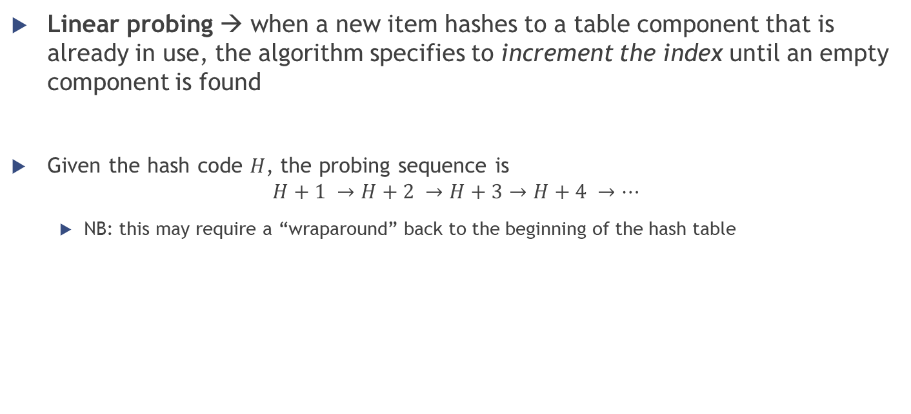
Hash table - Collision resolution with open addressing and linear probing
Linear probing → when a new item hashes to a table component that is already in use, the algorithm specifies to increment the index until an empty component is found
Given the hash code $H$, the probing sequence is
$$H+1 →H+2 →H+3→H+4 →…$$
NB: this may require a “wraparound” back to the beginning of the hash table

Slide 17
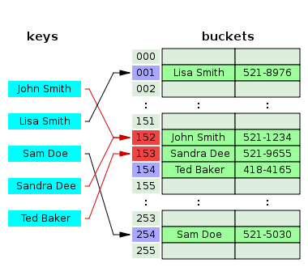
Hash table - Collision resolution with open addressing and linear probing
Linear probing examples
Tag & Rad from a few slides earlier
Sandra Dee; Ted Baker in the phonebook

Slide 18
Hash table - Collision resolution with open addressing and quadratic probing
Quadratic probing → taking the original hash index and adding successive values of an arbitrary quadratic polynomial until an open slot is found
Instead of searching linearly, it uses a squared increment
NB: this also may require a “wraparound” back to the beginning of the hash table
Given the hash code $H$, a possible quadratic probing sequence is:
$$H+1^{2} →H+2^{2} →H+3^{2}→H+4^{2} →…$$
Improved performance with respect to linear probing, but it is also more likely to result in an infinite loop…
Notes:
Infinite loop: for example, if the array has 6 elements (indices from 0 to 5) and the occupied slots are 0 1 3 and 4. If there is another element that tries to occupy slot 0, then a loop happens.

Slide 19

Hash table - Collision resolution with open addressing
Open addressing methods drawbacks
the number of stored entries cannot exceed the number of slots in the bucket array
performance dramatically degrades when the load factor grows beyond 0.7 → dynamic resizing is mandatory
more stringent requirements on the hash function
besides distributing the keys more uniformly over the buckets, the function must also minimize the clustering of hash values that are consecutive in the probe order

Slide 20
Hash table - Collision resolution with separate chaining
Instead of resolving collisions, we can avoid them… how?
Allowing more than one item per bucket!
Method called “separate chaining” because it uses linked lists (“chains”) to hold the multiple items

Slide 21
Hash table - Collision resolution with separate chaining
Instead of resolving collisions, we can avoid them… how?
Allowing more than one item per bucket!
Method called “separate chaining” because it uses linked lists (“chains”) to hold the multiple items
In a good hash table, each bucket has zero or one entries, and sometimes two or three, but rarely more than that
Otherwise performance in hash table operations decreases because we have to add the time for the list operation

Slide 22
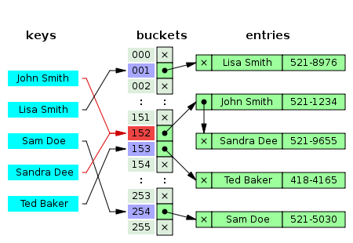
Hash table - Collision resolution with separate chaining
Example

Slide 23
Hash table - Collision resolution with separate chaining
Which data structure should we use to store the multiple items in each bucket?
Linked lists
Popular because it requires only basic data structures with simple algorithms
When storing small keys and values, the space overhead of the next pointer in each entry record can be significant
Traversing a linked list has poor cache performance, making the processor cache ineffective
Ordered lists, sorted by key field
Self-balancing search trees
Only worth the trouble and extra memory cost if long delays must be avoided at all costs (e.g. in a real-time application) or if one must guard against many entries hashed to the same slot (e.g. if one expects extremely non-uniform distributions, or in the case of web sites or other publicly accessible services, which are vulnerable to malicious key distributions in requests)
Dynamic arrays

Slide 24
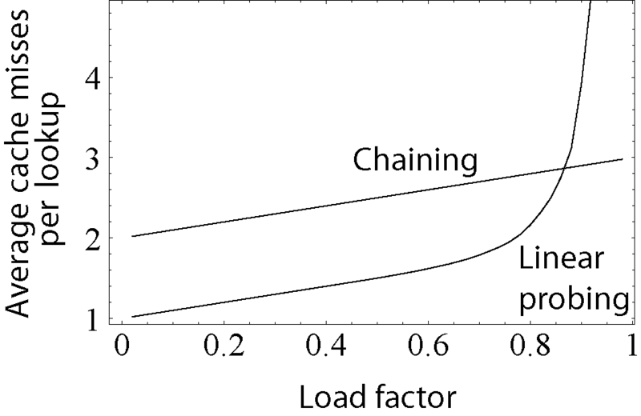
Hash table - Collision resolution
Comparison between the “performance” (seen as the average number of cache misses required to look up elements in tables) with separate chaining and linear probing
Linear probing's performance drastically degrades for load factors $>0.8$

Slide 25
Hash table – Dynamic resizing
A hash table functions well when the table size is proportional to the number of entries
Practical problem: usually the number of entries is not known in advance
Very important to provide some method to resize the table in order to prevent the hash table from becoming too full
Resizing happens only when the load factor becomes too large
In Java the default load factor threshold for table expansion is 0.75; in Python's dict 2/3
Resizing is accompanied by a full or incremental table rehash whereby existing items are mapped to new bucket locations

Slide 26
Hash table – Dynamic resizing
Resizing by copying all entries
Common approach → automatically trigger a complete resizing when the load factor exceeds some threshold
All the entries of the old table are removed and inserted into the new table
Incremental resizing
Some hash table implementations (especially real-time systems), cannot pay the price of enlarging the hash table all at once: it may interrupt time-critical operations
Keep both the old and the new table; do lookups and deletions in both tables; new insertions only in the new one; at each insertion move some elements from the old to the new table until they are all removed (and then deallocate the old table)

Slide 27
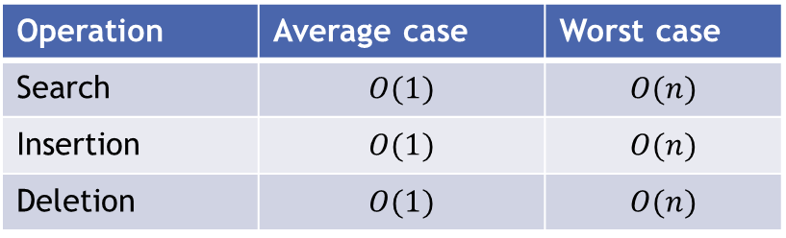
Hash table – Performance analysis
Average case
In a well-dimensioned hash table, the average cost (number of instructions) for each lookup is independent of the number of elements stored in the table
If the load factor is kept below some bound, the access functions are immediate, running in constant time → direct access, just like an array
Worst case
Worst choice of hash function → every insertion causes a collision → hash tables degenerate to linear search
Operation | Average case | Worst case
Search | $$O(1)$$ | $$O(n)$$
Insertion | $$O(1)$$ | $$O(n)$$
Deletion | $$O(1)$$ | $$O(n)$$

Slide 28
Hash table – Pros & Cons
Main advantage
Speed → particularly efficient when the maximum number of entries can be predicted in advance (no resize)
Disadvantages
The cost of a good hash function can be significantly higher than the inner loop of the lookup algorithm for a sequential list or search tree
hash tables not effective when the number of entries is very small
Entries can be enumerated only in pseudo-random order
no efficient way to locate an entry whose key is nearest to a given key → separate sorting step needed
With dynamic resizing, an insertion or deletion operation may occasionally take time proportional to the number of entries → problem in real-time or interactive applications
Quite inefficient when there are many collisions

Slide 29
Hash table – Applications
In many situations, hash tables turn out to be more efficient than search trees or any other table lookup structure → widely used in many kinds of computer software
systems programming
primary building blocks of relational databases
associative arrays
caches
sets
…

Slide 30
Hash tables in C#
Dictionary class
Generic with respect to the types of keys and values
http://www.dotnetperls.com/dictionary
http://msdn.microsoft.com/en-us/library/xfhwa508%28v=vs.110%29.aspx
Live demo?

Slide 31
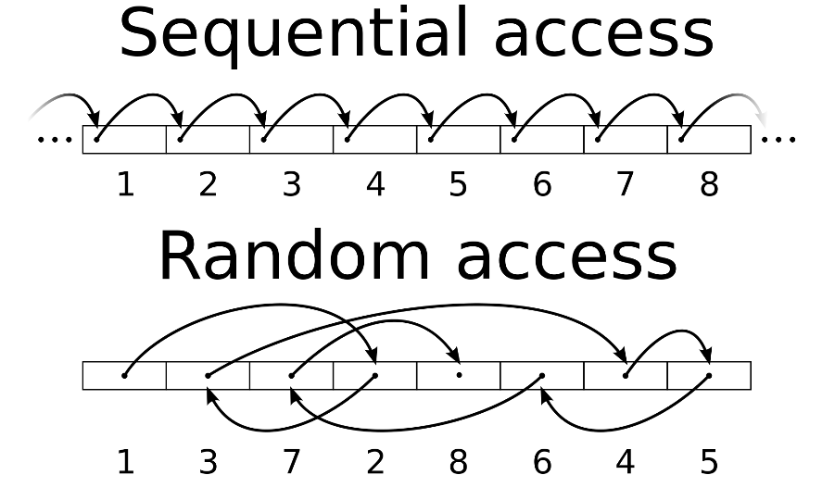
Summary
Array and Hash table
random access data structures → each element can be accessed directly and in constant time
Linked list
sequential access data structure → each element can be accessed only in a particular order
Stack & Queue
limited access data structures (subcase of sequential data structures)
Notes:
http://www.cs.cmu.edu/~adamchik/15-121/lectures/Stacks%20and%20Queues/Stacks%20and%20Queues.html

Slide 32
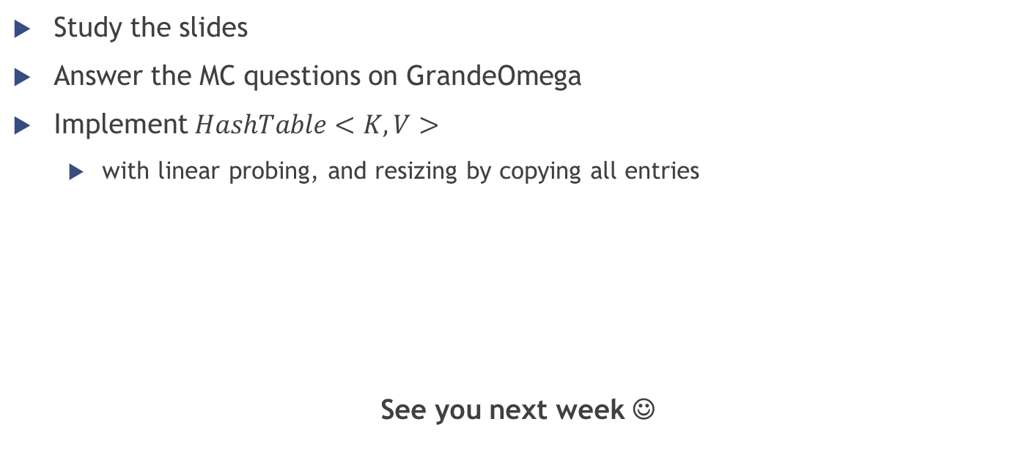
Homework
Study the slides
Answer the MC questions on GrandeOmega
Implement $HashTable<K,V>$
with linear probing, and resizing by copying all entries
See you next week ☺

